Slide 1

Notes:
Music
Type where you are from in the chat

Slide 5


Slide 7
The Association of International Educators and Leaders of Color (AIELOC) is devoted to amplifying the work of international educators and leaders of color with a focus on advocacy, learning, and research.
About AIELOC

Slide 8


Slide 9




Slide 10

Flow
Norms and Goals
Ecosystem
Mapping Our Roles
Breakout
Closing

Slide 11

Norms
Stay Engaged
Experience Discomfort
Speak Your Truth
Expect and accept non-closure

Slide 12
Community visioning is a process that gives stakeholders the opportunity to express ideas about the future of their community.
Our goals are to begin to learn about our individual and collective experiences, envision what would the international school ecosystem look and feel without racism and discrimination, and to explore ways to end racism and discrimination.

Slide 13
Vocabulary
Racism: Personal prejudice and bias and the systemic misuse and abuse of of power by institutions (Tiffany Jewell, This Book is Anti-Racist)
Discrimination: The denial of justice, resources and fair treatment of individuals and groups (often based on social identity)
Ecosystem: A system or group or community that interacts with each other in a specific environment

Slide 14







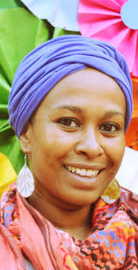

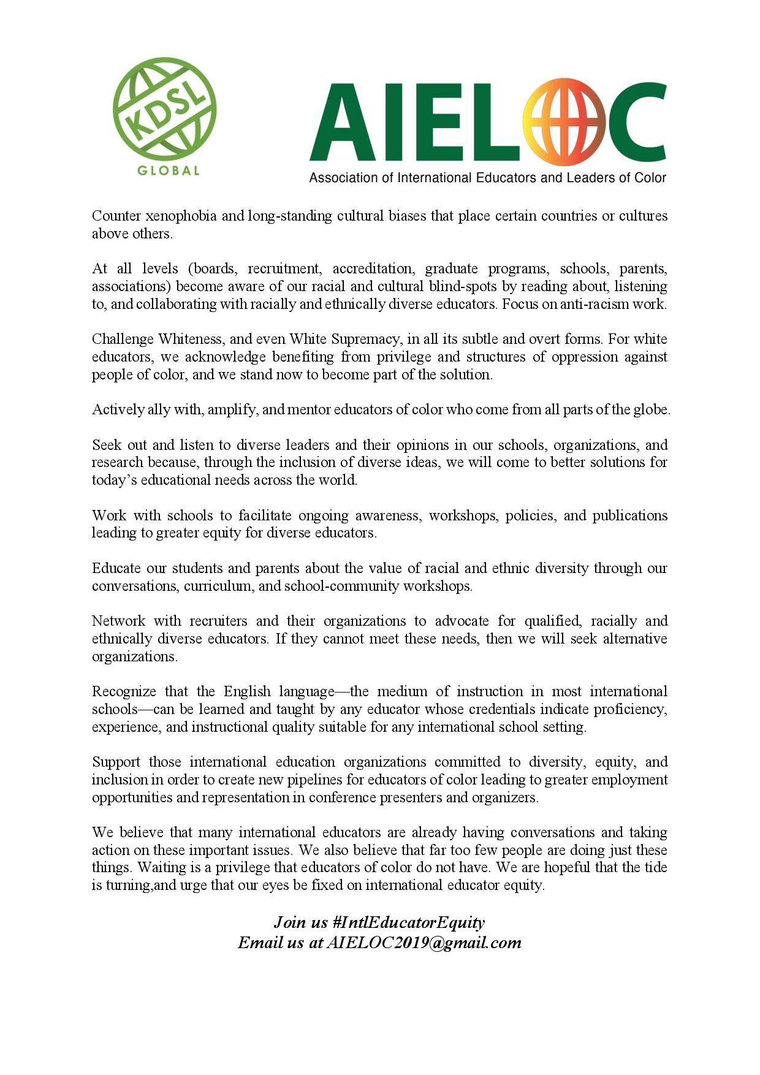

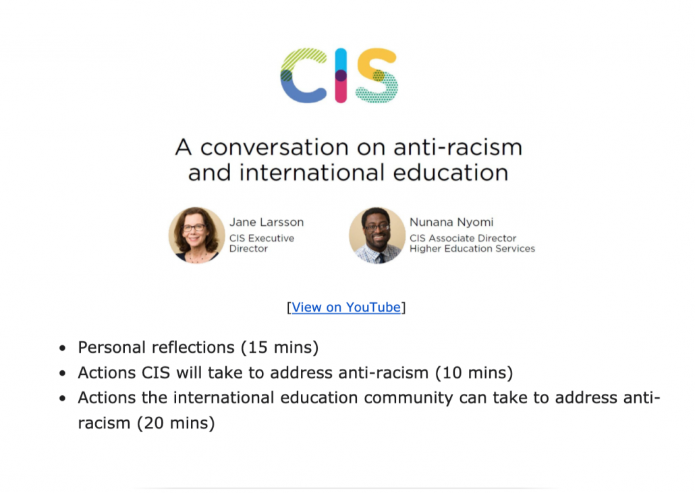
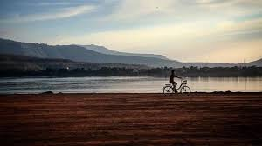
Notes:
Notice
Wonder
Whose speaking, silent

Slide 16
Task
In your breakout:
  Introduce yourselves
  Visit http://aieloc.org/webinars-and-events/ (Community Visioning)
  View the Playing Your Part with The Movement video from 11:00-26:55
  Mapping Our Roles in Social Change Ecosystem
  Discuss the roles and spend time on pages 5-6

Slide 17
Closing
Reflections
Commitment to Action: https://padlet.com/kdsl2007/ga6oin5r650qelw2

Slide 18
Save the Date
February 20 at 9am EST
Complete Mapping Our Roles in Social Change Ecosystem pages 7-8
Questions:
  Does your community experience racism and discrimination? How?
  How would the international school ecosystem look and feel without racism and discrimination?
  What will it take to end racism and discrimination in the international school ecosystem? What do we need to consistently do?

Slide 19
Notes:
Music
Type where you are from in the chat

